Slide 1

Math at home adds up to achievement in school
by Talia Berkowitz, Marjorie W. Schaeffer, Erin A. Maloney, Lori Peterson, Courtney Gregor, Susan C. Levine, and Sian L. Beilock
Science
Volume 350(6257):196-198
October 9, 2015
Published by AAAS

Slide 2
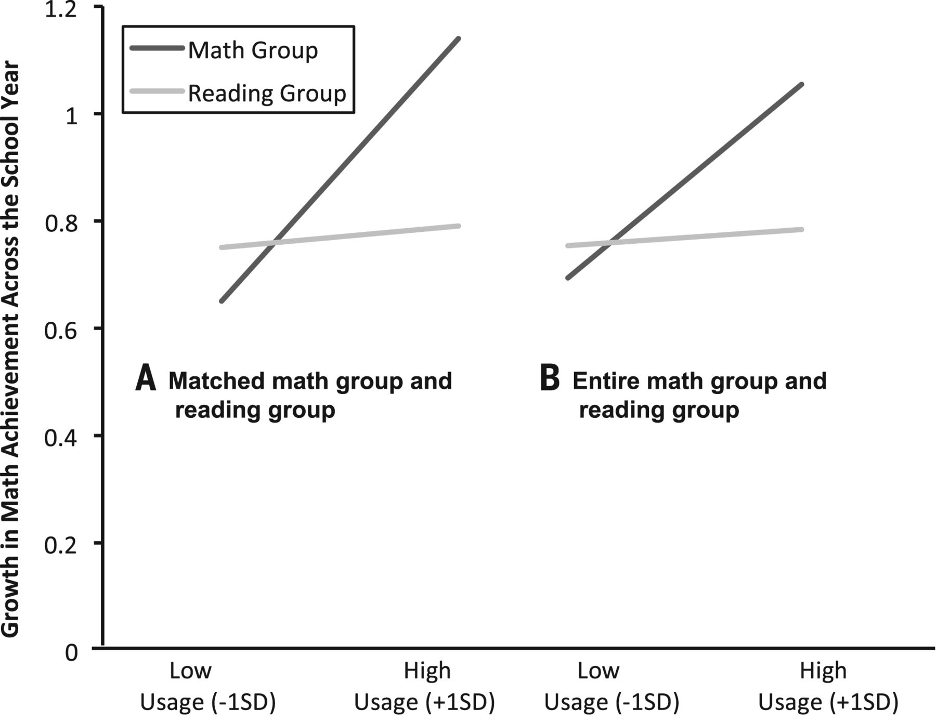
Fig. 1 Estimated number of months of math knowledge children gained across the school year (1 equals 9 months or one school year) as a function of average weekly app use. .
Talia Berkowitz et al. Science 2015;350:196-198
Published by AAAS
Notes:
Estimated number of months of math knowledge children gained across the school year (1 equals 9 months or one school year) as a function of average weekly app use.

Slide 3
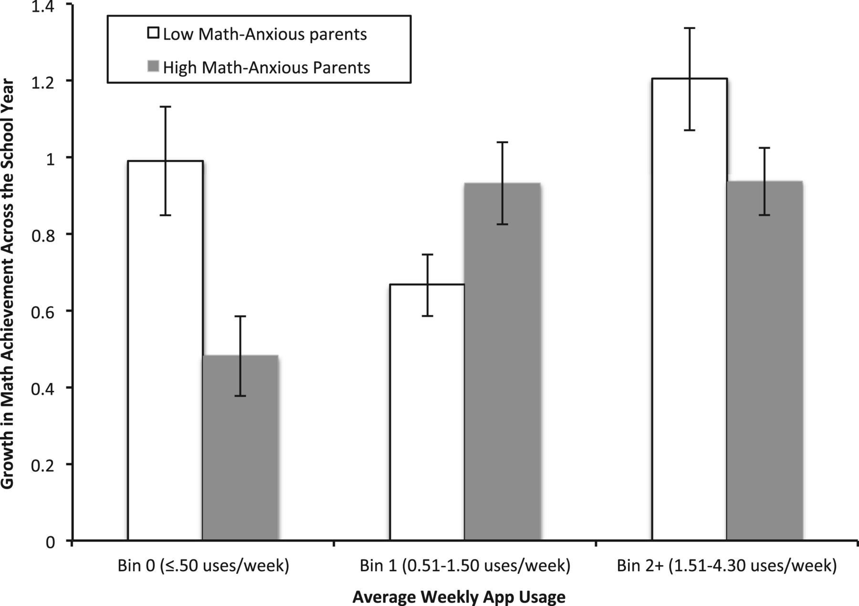
Fig. 2 Number of months of math knowledge children gained across the school year (1 equals 9 months or one school year) as a function of average weekly app use and parents’ math anxiety. .
Talia Berkowitz et al. Science 2015;350:196-198
Published by AAAS
Notes:
Number of months of math knowledge children gained across the school year (1 equals 9 months or one school year) as a function of average weekly app use and parents’ math anxiety.

